Slide 1
Computer Architecture
Atul Kahate

Slide 2
Basics

Slide 3
Digital Computer
A digital computer is a machine that can do work for people by carrying out instructions given to it.
A sequence of instructions describing how to perform a certain task is called a program.
The electronic circuits of each computer can recognize and directly execute a limited set of simple instructions into which all its programs must be converted before they can be executed.
These basic instructions are rarely much more complicated than
Add two numbers.
Check a number to see if it is zero.
Copy a piece of data from one part of the computer’s memory to another.

Slide 4
Machine language
Together, a computer’s primitive instructions form a language in which people can communicate with the computer.
Such a language is called a machine language.
The people designing a new computer must decide what instructions to include in its machine language.
Usually, they try to make the primitive instructions as simple as possible to reduce the complexity and cost of the electronics needed.
Because most machine languages are so simple, it is difficult for people to use them.

Slide 5
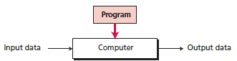
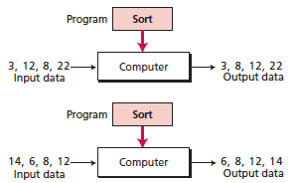
A programmable computer

Slide 6
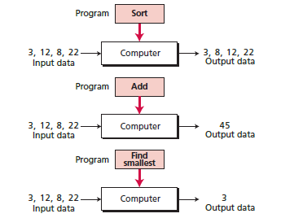
Same data, different programs

Slide 7
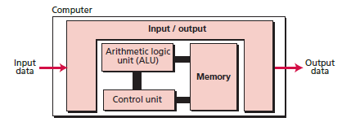
The von Neumann model

Slide 8
Number Systems

Slide 9

Digital computers
Computers function reliably if only two states are used
Because of the physical restriction of components and because human logic tends to be binary (true/false, yes/no), digital computers take only two values, hence binary
A binary digit is bit

Slide 10
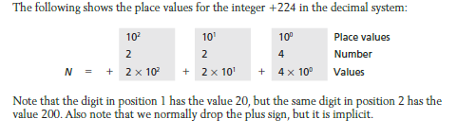
Decimal Number System

Slide 11
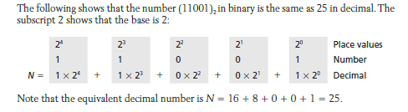
Binary Number System

Slide 12
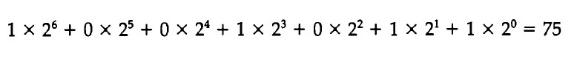
Binary number system
Use of only 0 and 1
So, we need to be able to convert from binary to decimal and vice versa
Example: Convert binary 1001011 into decimal

Slide 13
Exercises
Convert the following decimal numbers into binary:
1234
88
Convert the following binary numbers into decimal:
01101
1011000

Slide 14
Hexadecimal Number System
Uses 16 symbols
Numbers 0 to 9 are used as in decimal number system
Letters A to F are used for more digits, i.e.
0, 1, 2, … 9
A = 10
B = 11
C = 12
D = 13
E = 14
F = 15

Slide 15
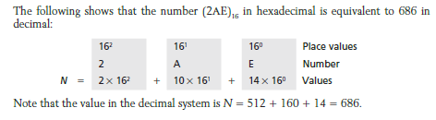
Hexadecimal Number System

Slide 16
Exercises
Convert the following hexadecimal numbers into decimal (Hint: Multiply by 16⁰, 16¹, 16² from right to left and add all the values)
AB2
123
Convert the following decimal numbers into hexadecimal (Hint: Divide by 16 continuously, writing the remainder on the right, last value and remainder written in the reverse order will be the answer)
567
1411
16

Slide 17
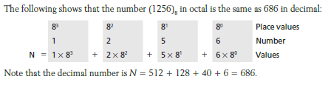
Octal Number System

Slide 18
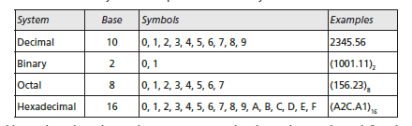
Number Systems: Summary

Slide 19
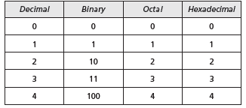
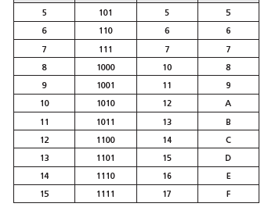
Comparison

Slide 20
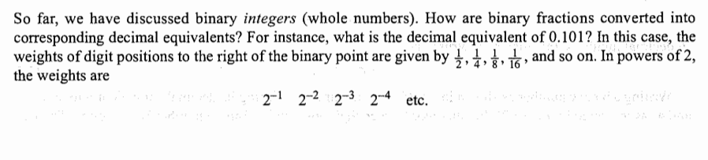
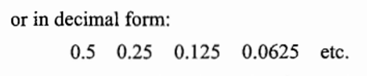
Fractions

Slide 21
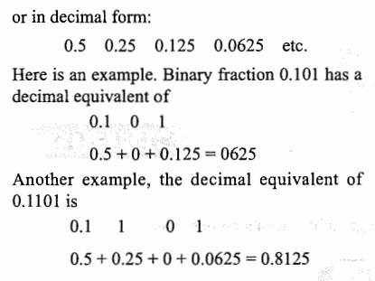
Binary fractions

Slide 22
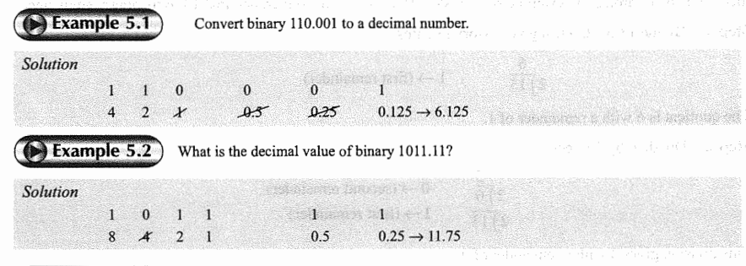
Examples

Slide 23
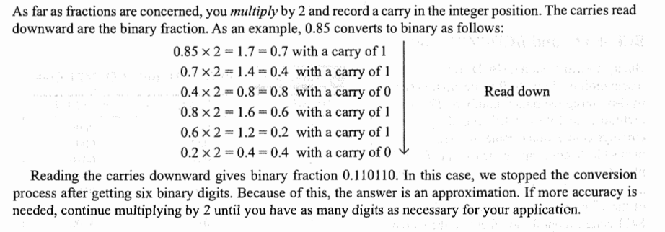
Decimal to binary: Fractions

Slide 24
Summary: Binary to Decimal and Back
Input | Output | Technique
Binary integer | Decimal integer | ‘8421’ or multiply left to right with 2 raised to 0, 2 raised to 1 etc and add
Binary fraction | Decimal fraction | 0.5, 0.25, 0.125, …
Decimal integer | Binary integer | Divide by 2 and write remainder in the reverse order
Decimal fraction | Binary fraction | Multiply by 2, write carry, Ignore carry, Forward direction

Slide 25
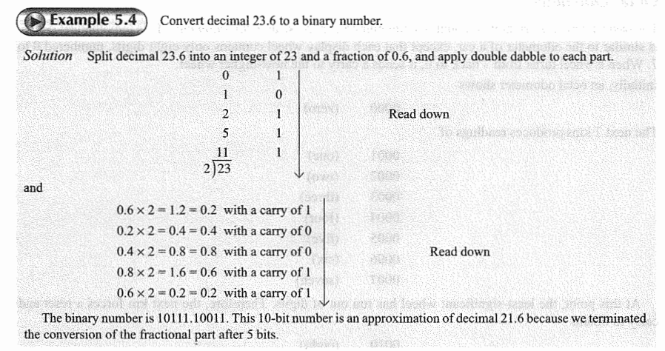
Decimal to binary: Mixed number

Slide 26
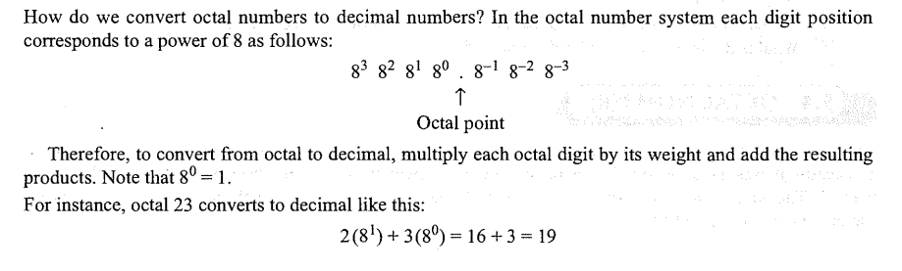
Octal to decimal

Slide 27
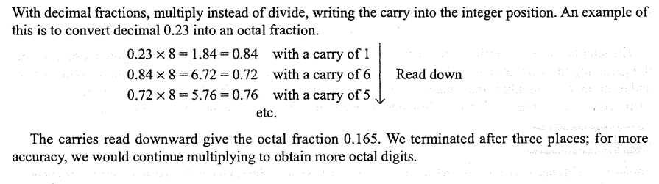
Decimal to octal with fractions

Slide 28
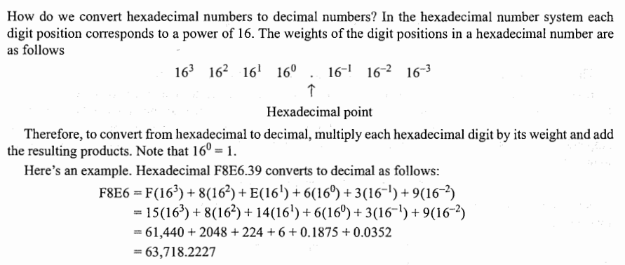
Hex to decimal fractions

Slide 29
Logic gates
Binary information is represented in digital computers by electrical signals (e.g. 3 volts = binary 1, 0.5 volts = binary 0)
Logic circuits called as gates manipulate binary information
Gates are blocks of hardware that produce binary 0 or 1 signals when input logic requirements are satisfied
A variety of such gates are used in computers
See next slide

Slide 30
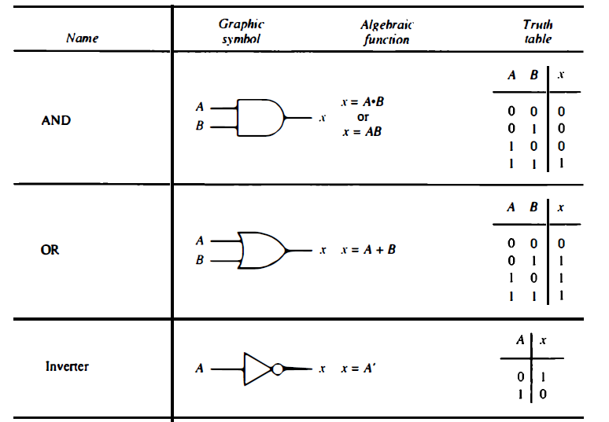
Three basic logic gates

Slide 31
Combinational circuits
A combinational circuit is a connected arrangement of logic gates with a set of inputs and outputs
Example: Half-adder (Adds 2 bits)
If we want to add 3 bits (i.e. 2 bits and a carry), we need a full-adder
A half-adder consists of an exclusive-OR (XOR) gate and an AND gate
See next slide

Slide 32
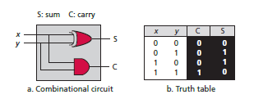
Half-adder
The output variables are the sum and carry.
It is necessary to specify two output variables because the sum of 1 + 1 is binary 10, which has two digits.
We assign symbols x and y to the two input variables, and S (for sum) and C (for carry) to the two output variables.
The truth table for the half-adder shows that the C output is 0 unless both inputs are 1. The S output represents the least significant bit of the sum.

Slide 33
What about data storage? Flip-flops …
A flip-flop is a binary cell capable of storing one bit of information.
A flip-flop maintains a binary state until directed by a clock pulse to switch states.
The difference among various types of flip-flops is in the number of inputs they possess and in the manner in which the inputs affect the binary state.

Slide 34
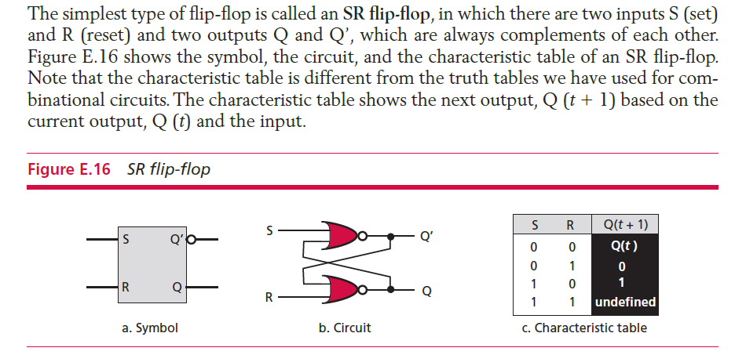
Example: SR flip-flop

Slide 35
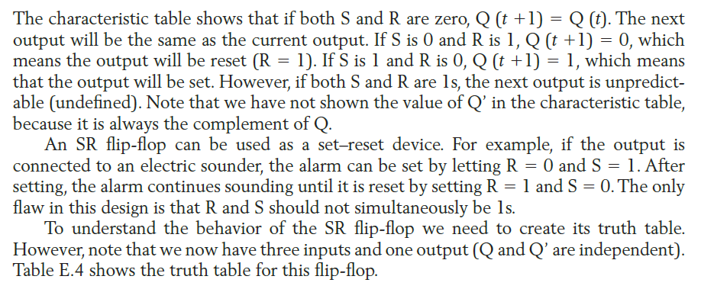
SR flip-flop working (Truth table next)

Slide 36
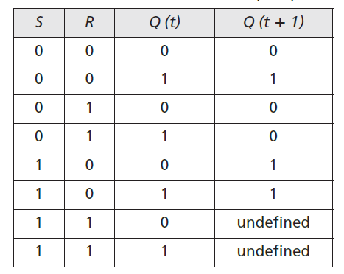
SR flip-flop truth table

Slide 37
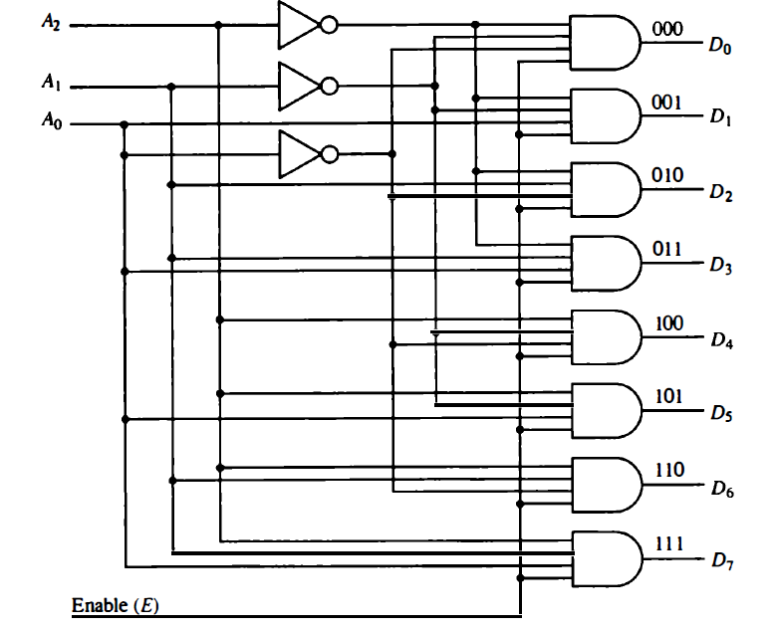
Decoder (3-to-8)

Slide 38
Decoder Working
The three data inputs, Ao, A1, and A2, are decoded into eight outputs, each output representing one of the combinations of the three binary input variables.
The three inverters provide the complement of the inputs, and each of the eight AND gates generates one of the binary combination.
A particular application of this decoder is a binary-to-octal conversion. The input variables represent a binary number and the outputs represent the eight digits of the octal number system.
However, a 3-to-8-line decoder can be used for decoding any 3-bit code to provide eight outputs, one for each combination of the binary code.

Slide 39
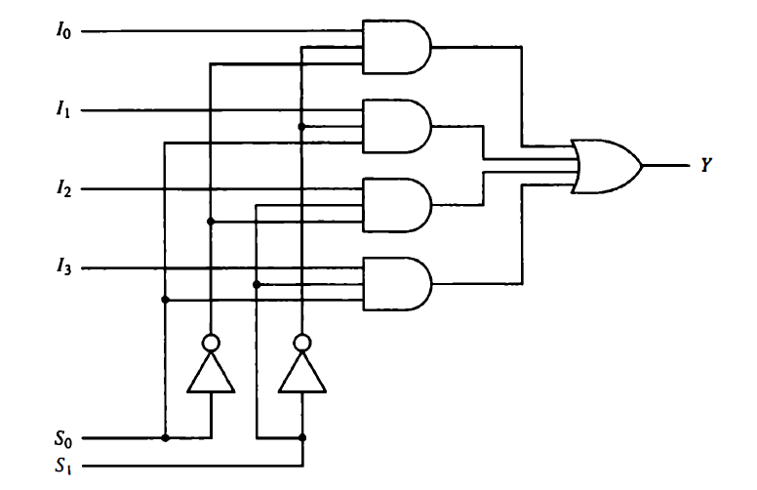
Multiplexer (4-to-1)

Slide 40
Multiplexer Working
A multiplexer is a combinational circuit that receives binary information from one of 2^{n} input data lines and directs it to a single output line. The selection of a particular input data line for the output is determined by a set of selection inputs.
A 2^{n}-to-1 multiplexer has 2^{n} input data lines and n input selection lines whose bit combinations determine which input data are selected for the output.
In our example, each of the four data inputs I0 through I3, is applied to one input of an AND gate. The two selection inputs S1 and S0 are decoded to select a particular AND gate. The outputs of the AND gates are applied to a single OR gate to provide the single output.
Consider the case when S1S0 = 10.
The AND gate associated with input I2, has two of its inputs equal to 1. The third input of the gate is connected to I2.
The other three AND gates have at least one input equal to 0, which makes their outputs equal to 0.
The OR gate output is now equal to the value of I2, thus providing a path from the selected input to the output.

Slide 41
Binary Arithmetic

Slide 42
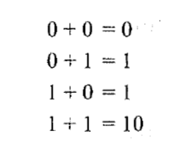
Binary Addition

Slide 43
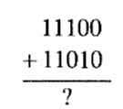
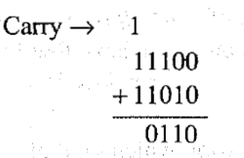
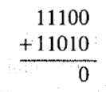
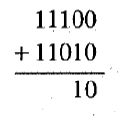
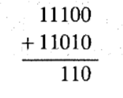
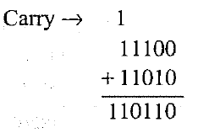
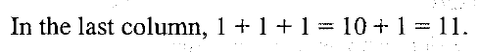
Adding Large Binary Numbers

Slide 44
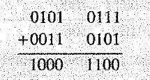
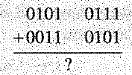
Exercise

Slide 45
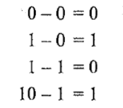
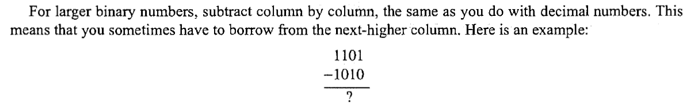
Binary Subtraction

Slide 46
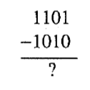
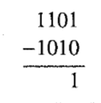
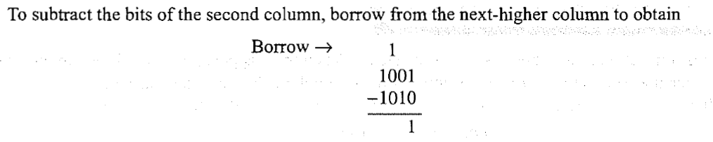
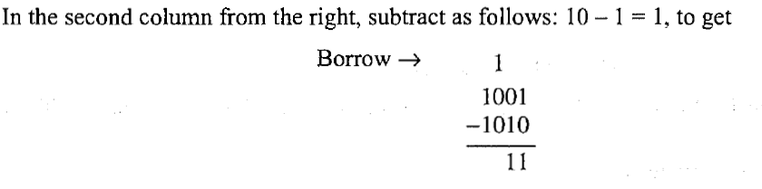
Binary Subtraction Example
For the second column from right, we had to do 0 – 1. Since it is not possible, we took 1 from the third column from right. So, our second column of right calculation became 10 – 1 = 1

Slide 47
Binary Subtraction Example
But because we have already borrowed the 1 from the second column to the right into the third column of right, this 1 is gone, and it has become 0 for the third column from right
That is, our original calculation was
Now it is And so, the 1 here will become 0
1 1 0 1
-
1 0 1 0
1 1 0 1
-
1 0 1 0
1 0 10 1
-
1 0 1 0

Slide 48
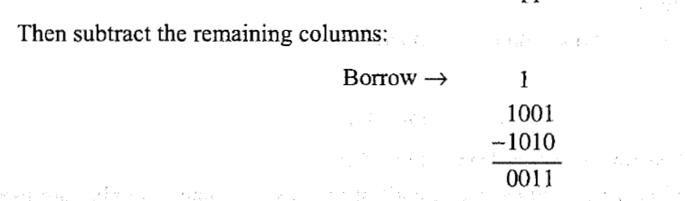
Binary Subtraction Example

Slide 49
Binary Numbers and Signs

Slide 50
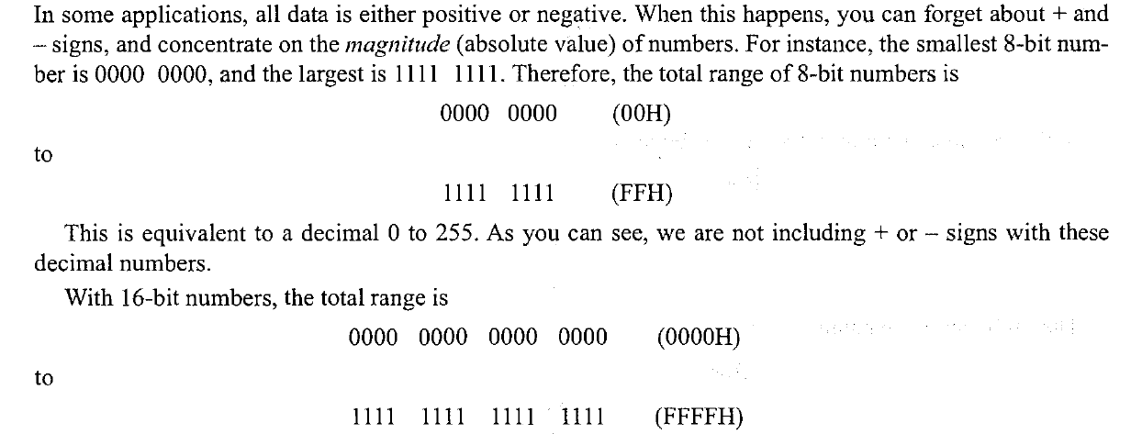
Unsigned Binary Numbers

Slide 51
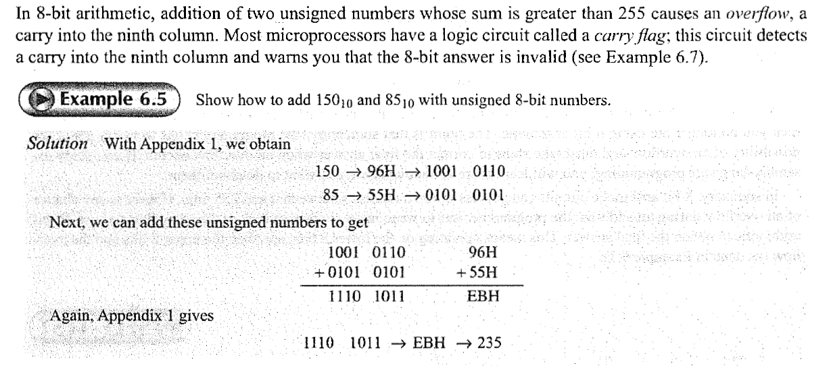
Overflow

Slide 52
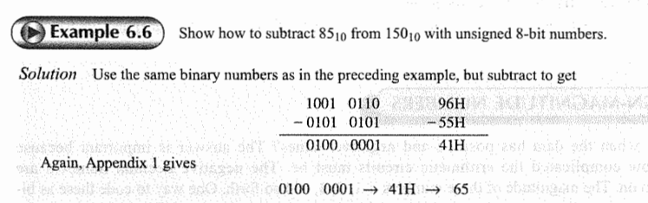
Binary Subtraction

Slide 53
Sign and Magnitude Representation – 1
In this, the available range for unsigned integers is divided into two equal halves
The first half is used for positive integers
The second half is used for negative integers
Leftmost bit (Most Significant Bit or MSB) is used to store sign: Contains 0 if positive and 1 if negative
Example: Consider that we have 4 bits to store integers
We know that the range is 0000 to 1111
It is divided into two parts: 0000 to 0111 and 1000 to 1111

Slide 54
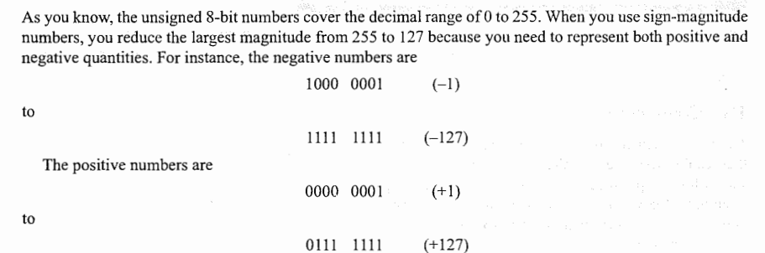
Sign and Magnitude Numbers

Slide 55
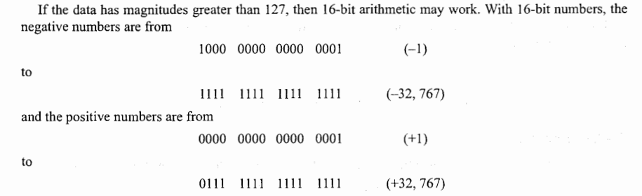
Sign and Magnitude Numbers

Slide 56
Sign and Magnitude Representation – 2
Observations
Normally negative numbers are to the left of the positive numbers, but here it is the opposite
We have two zeroes: positive 0 (0000) and negative 0 (1000)
Since one bit is reserved for sign, only 7 bits are available for value

Slide 57

Example – 1

Slide 58

Example – 2

Slide 59

Example – 3

Slide 60

Example – 3

Slide 61
Sign and Magnitude Numbers
The main advantage of sign-magnitude numbers is their simplicity.
Negative numbers are identical to positive numbers, except for the sign bit.
Because of this, you can easily find the magnitude by deleting the sign bit and converting the remaining bits to their decimal equivalents.
If you don't have to add or subtract the data, sign-magnitude numbers are acceptable.
Unfortunately, sign-magnitude numbers have limited use because they require complicated arithmetic circuits.
Solution: 2’s complement representation

Slide 62

1’s Complement Representation

Slide 63

2’s Complement Representation

Slide 64

More Examples

Slide 65

Why 2’s Complement? – Part 1

Slide 66

Why 2’s Complement? – Part 2

Slide 67

Why 2’s Complement? – Part 3

Slide 68
Conclusion
What does the foregoing mean? It means that taking the 2's complement is equivalent to negation, changing the sign of the number. Why is this important? Because it's easy to build a logic circuit that produces the
2's complement. Whenever this circuit takes the 2's complement, the output is the negative of the input.
This key idea leads to an incredibly simple arithmetic circuit that can add and subtract.
In summary, here are the things to remember about 2' s complement representation:
1. Positive numbers always have a sign bit of 0, and negative numbers always have a sign bit of 1.
2. Positive numbers are stored in sign-magnitude form.
3. Negative numbers are stored as 2's complements.
4. Taking the 2's complement is equivalent to a sign change.

Slide 69
One’s and Two’s Complement
One’s complement of an integer: This operation simply changes each 0-bit to a 1-bit, and a 1-bit is changed to a 0-bit. (NOT gate)
Almost all computers use two’s complement representation to store a signed integer
A very interesting point about two’s complement is that there is only one zero in this representation.
In sign-and-magnitude representation, there are two zeros (+0 and -0).
Two’s complement representation is the standard representation for storing integers in computers today.

Slide 70

Example

Slide 71

Example

Slide 72
Two’s Complement: Another method
Take 1’s complement of a number and add 1
Example: Original number is 0101
One’s complement: 1010
Two’s complement: 1011
Verify using the earlier technique (copy from right until a 1 is copied, then flip bits)
0 1 0 1 Original number
1 0 1 1 Two’s complement

Slide 73

Problems
Store the integer 28 in an 8-bit memory location using two’s complement representation.

Slide 74

Problems
Store the integer -28 in an 8-bit memory location using two’s complement representation.

Slide 75

Problems
Retrieve the integer that is stored as 00001101 in memory in two’s complement format.

Slide 76

Problems
Retrieve the integer that is stored as 11100110 in memory using two’s complement format.

Slide 77

Comparison of the three systems (Sample on next slide)

Slide 78
Samples from previous table
Let us take memory contents from row number 8, which are 1000
Leftmost bit is 1, so number is negative, so 2’s complement must be found
If we calculate 2’s complement of 1000, it is 1000, i.e. the same number
1000 in binary is 8 in decimal
Because the first bit is 1, it must be negative
Hence, 2’s complement value of 1000 is -8
Another example: 0110
Leftmost bit is 0, so number is positive, so 2’s complement is not necessary
Simply convert to decimal: 6 and sign is also positive, so +6

Slide 79
2’s Complement Arithmetic – Addition
There are four possible cases:
Both numbers positive,
A positive number and a smaller negative number,
A negative number and a smaller positive number,
Both numbers negative. Let us go through all four cases

Slide 80

Case 1 – Both positive

Slide 81

Case 2 – Positive and Smaller negative
Quick trick to obtain binary 2’s complement of 68: What is +68 in binary? 0100 0100. Using our trick, its 2’s complement will be 1011 1100

Slide 82

Case 3: Positive and Larger negative

Slide 83

Case 4: Both negative

Slide 84
Conclusion
In every case, 2's complement addition works.
In other words, as long as positive and negative numbers are expressed in 2's complement representation, an adding circuit will automatically produce the correct answer.
This assumes the decimal sum is within the -128 to+ 127 range. If not, you get an overflow.

Slide 85

2’s Complement Subtraction
Format for subtraction:
There are four cases: both numbers positive, a positive number and a smaller negative number, a negative number and a smaller positive number, and both numbers negative.
The question now is how can we use an adding circuit to do subtraction. From algebra, you already know that adding a negative number is equivalent to subtracting a positive number.
If we take the 2's complement of the subtrahend, addition of the complemented subtrahend gives the correct answer.
Remember that the 2' s complement is equivalent to negation.
One way to remove all doubt about this critical idea is to analyze the four cases that can arise during a subtraction.

Slide 86

Case 1: Both positive

Slide 87

Case 2: Positive and Smaller negative

Slide 88

Case 3: Positive and Larger negative

Slide 89

Case 4: Both negative

Slide 90
Overflow
We have covered all cases of addition and subtraction.
2's complement arithmetic works and is the standard method used in microcomputers. In 8-bit arithmetic, the only thing that can go wrong is a sum outside the range of -128 to + 127. When this happens, there is an overflow into the sign bit, causing a sign change.
With the typical microcomputer, the programmer has to write instructions that check for this change in the sign bit.
Let's take a look at overflow problems.
Assume that both input numbers are in the range of -128 to +127.
If a positive and a negative number are being added, an overflow is impossible because the answer is always less than the larger of the two numbers being added.
Trouble can arise only when the arithmetic circuit adds two positive numbers or two negative numbers. Then, it is possible for the sum to be outside the range of -128 to +127.

Slide 91

Overflow Case 1: Two positive numbers

Slide 92

Overflow Case 2: Two negative numbers

Slide 93
Computer Systems Organization

Slide 94
Main components of a Computer
Processor
Memory
Input-output devices

Slide 95
Processor
Processor or Central Processing Unit (CPU) is the brain of the computer
Main job: Execute programs stored in the main memory by fetching their instructions (code), examining them one-by-one and executing them
Components inside a processor are connected using a bus (collection of parallel wires) for transmitting address, data, and control signals
Buses can be internal to the CPU or outside also

Slide 96
Parts of the CPU
Control unit: Responsible for fetching instructions from main memory and determining their type
Arithmetic Logic Unit (ALU): Performs operations such as addition and Boolean AND needed to carry out the instructions
See next slide

Slide 97

Computer Organization

Slide 98
More on the CPU
The CPU also contains a small, high-speed memory used to store temporary results and certain control information.
This memory is made up of a number of registers, each having has a certain size and function.
Usually, all the registers have the same size.
Each register can hold one number, up to some maximum determined by its size.
Registers can be read and written at high speed since they are internal to the CPU.

Slide 99

Data Path in a CPU

Slide 100
ALU Operation – An Example
Let us say our ALU computes a fixed set of functions
out = f_{i}(x, y)
where x and y are the chip’s two 16-bit inputs, out is the chip’s 16-bit output, and f_{i} is an arithmetic or logical function selected from a fixed set of 18 possible functions.
We instruct the ALU which function to compute by setting 6 input bits, called control bits, to selected binary values.

Slide 101


Sample ALU Circuit

Slide 102

ALU Operation

Slide 103

Our ALU
Meaning: If the zx input pin is 1, it will make x bit 0

Slide 104

ALU Operation

Slide 105

ALU Operation

Slide 106
Memory
The memory is that part of the computer where programs and data are stored.
Memories consist of a number of cells (or locations), each of which can store a piece of information.
Each cell has a number, called its address, by which programs can refer to it.
If a memory has n cells, they will have addresses 0 to n − 1.
All cells in a memory contain the same number of bits.

Slide 107

Memory Example

Slide 108

Address Bus versus Data Bus

Slide 109
Basic Concepts
A digital computer is a machine that can do work for people by carrying out instructions given to it.
A sequence of instructions describing how to perform a certain task is called a program.
A computer’s basic instructions form a language in which people can communicate with the computer
Such a language is called a machine language
The people designing a new computer must decide what instructions to include in its machine language
Usually, they try to make the primitive instructions as simple as possible consistent with the computer’s intended use and performance requirements
Because most machine languages are so simple, it is difficult and tedious for people to use them

Slide 110
Programming Language Generations
Generation | Language | Example
1st | Machine language | Binary language
2nd | Assembly language | Computer 8086’s assembly language
3rd | High level language | C, Java, Pascal
4th | Very high level language | SQL

Slide 111
Computer Organization and Architecture
The implementation of a computer has two components: organization and hardware
The term organization includes the high-level aspects of a computer’s design, such as the memory system, the memory interconnect, and the design of the internal processor or CPU (central processing unit)
The term microarchitecture is also used instead of organization

Slide 112
Computer Architecture versus Organization
Architecture: The what question – Tells us what a computer can do
Organization: The how question – How all the units in the computer are arranged and interconnected

Slide 113
Brief History of Computers
Generation | Time Period | Details
0th (Mechanical computers) | 1642-1945 | Mechanical devices (e.g. Difference Engine and Analytical Engine of Charles Babbage) – See next slide Konrad Zuse’s calculating machines using electric relays John Atanasoff’s calculator
1st (Vacuum tubes) | 1945-1955 | COLOSSUS in England (Alan Turing), ENIAC (Mauchley and Eckert)
2nd (Transistors) | 1955-1965 | Digital Equipment Corporation (DEC) PDP-1, CDC 6600, Cray Supercomputers
3rd (Integrated Circuits or ICs) | 1965-1980 | IBM System/360 series of computers – Same assembly language, multiple computers, introduced multiprogramming,
4th (Very Large Scale Integration or VLSI) | 1980-Ongoing | IBM and other ‘cloned’ Personal Computers (PC), Apple Macintosh, CP/M and DOS operating systems, Intel 80836 chip in 1985 (x86)
5th (Low power and invisible computers) | 1990s onwards | PDAs, Smart phones, IoT

Slide 114

Analytical Engine and Charles Babbage

Slide 115

Computer Performance – Moore’s Law

Slide 116

Intel x86 Architecture – The start
In 1968, Intel Corporation was formed by three people to make memory chips

Slide 117
Intel x86 Architecture – CPU-related Work
In the late 1960s, calculators were large electromechanical machines the size of a modern laser printer and weighing 20 kg
In 1969, a Japanese company, Busicom, approached Intel with a request that it manufacture 12 custom chips for a proposed electronic calculator
The Intel engineer assigned to this project, Ted Hoff, looked at the plan and realized that he could put a 4-bit general-purpose CPU on a single chip that would do the same thing and be simpler and cheaper as well
Thus, in 1970, the first single-chip CPU, the 2300-transistor 4004, was born

Slide 118


Intel x86 Architecture – CPU-related Work
Ted Hoff and the 400 chip

Slide 119
Intel x86 Architecture – 8080
When Intel decided that it might be worth a try to use the 4004 in other projects, it offered to buy back all the rights to the new chip from Busicom by returning the $60,000 Busicom had paid Intel to develop it
Intel’s offer was quickly accepted, at which point it began working on an 8-bit version of the chip, the 8008, introduced in 1972
Intel did not expect much demand for the 8008, so it set up a low-volume production line. Much to everyone’s amazement, there was an enormous amount of interest, so Intel set about designing a new CPU chip that got around the 8008’s limit of 16 kilobytes of memory (imposed by the number of pins on the chip)
This design resulted in the 8080, a small, general-purpose CPU, introduced in 1974
Intel sold millions of these chips

Slide 120
Intel x86 Architecture – 8088 and 80286
In 1978 came the 8086, a genuine 16-bit CPU on a single chip (Meaning: its arithmetic logic unit, internal registers and most of its instructions are designed to work with 16-bit binary words. Also, it has a 16-bit data bus, so it can read data from or write data to memory and ports either 16 bits or 8 bits at a time)
The 8086 was designed to be similar to the 8080, but it was not completely compatible with the 8080
The 8086 was followed by the 8088, which had the same architecture as the 8086 and ran the same programs but had an 8-bit bus instead of a 16-bit bus, making it both slower and cheaper than the 8086
When IBM chose the 8088 as the CPU for the original IBM PC, this chip quickly became the personal computer industry standard
Neither the 8088 nor the 8086 could address more than 1 megabyte of memory (because if had 20-bit address bus).
By the early 1980s this had become a serious problem, so Intel designed the 80286, an upward compatible version of the 8086
The basic instruction set was essentially the same as that of the 8086 and 8088
The 80286 was used in the IBM PC/AT and in the midrange PS/2 models
Like the 8088, it was a huge success, mostly because people viewed it as a faster 8088

Slide 121
Intel x86 Architecture – x86
The next logical step was a true 32-bit CPU on a chip, the 80386, brought out in 1985 (called x86 now) – Data and address bus each of 32 bits
Like the 80286, this one was more or less compatible with everything back to the 8080 (which was a pain!)
Then came 80486
At this point, Intel found out the hard way (by losing a trademark infringement lawsuit) that numbers (like 80486) cannot be trademarked, so the next generation got a name: Pentium
In 2006, Intel changed the brand name from Pentium to Core and released a dual core chip, the Core 2 duo (Dual core is a CPU that has two distinct processors that work simultaneously in the same integrated circuit)

Slide 122

The Intel CPU Family

Slide 123
Intel Processor

Slide 124
32-bit Processor
The 32-bit processor was the primary processor used in all computers until the early 1990s.
32-bit is a type of CPU architecture which is capable of transferring 32 bits of data. It is the amount of information which can be processed by your CPU whenever it performs an operation.
Intel Pentium processors and early AMD processors were 32-bit, which means the operating system and software work with data units that were 32 bits wide.
Windows 95, 98, and XP were all 32-bit operating systems.

Slide 125
64-bit Processor
Microsoft released a 64-bit version of Windows XP to be used on computers with a 64-bit processor.
In computer architecture, 64 bit refers to the number of bits which should be processed or transmitted in parallel or the number of bits used for a single element in a data format. A 64-bit microprocessor allows computers to process data and memory address which are represented by 64 bits.
Windows Vista, Windows 7, and Windows 8 also come in 64-bit versions.
32-bit processors have 4 GB addressable space while 64-bit processors have 16 exabytes addressable space.

Slide 126
Intel Core Processors
Intel Core processors are Intel’s flagship family of CPUs.
First released in 2006, they replaced the popular Pentium line as the standard for high-end processor chips.
They’re available in different models like Core i3, i5, i7, i9, and X, and they bring a new generation to market every 1 to 2 years.

Slide 127
Intel Xeon Processors
Intel Xeon processors are the brand’s line of business CPUs.
They have comparable clock speeds to the Core family of processors.
Where they shine is their support for ECC error-correcting memory, which is a must for critical computing applications, like financial or scientific computing.

Slide 128
Intel Pentium Processors
Intel Pentium processors are mid-to-entry level CPUs that deliver high value at more modest price points than the Core and Xeon processor lines.
These chips manage similar clock speeds to the more robust Core chips, keeping prices down by not including premium features.

Slide 129
Intel Celeron Processors
Intel Celeron processors are a line of desktop and laptop CPUs based on the Pentium 4-core chip.
They have less cache memory and reduced speeds, making them a much more affordable choice for those who stick to browser-based activities and non-processor-heavy applications.

Slide 130
AMD Processor
AMD stands for Advanced Micro Devices.
It is an American multinational semiconductor company based in Santa Clara, California.
AMD processors are cheaper than Intel Processors at a similar range.
Laptops powered with Ryzen processors often clock lower and less aggressively compared to Intel-powered laptops.
They often run cooler and longer on battery. Thus for laptops, they are better.

Slide 131
The ARM Architecture
In the early 80s, the U.K.-based company Acorn Computer, flush with the success of their 8-bit BBC Micro personal computer, began working on a second machine with the hope of competing with the recently released IBM PC
The BBC Micro was based on their own 8-bit 6502 processor
They called their design the Acorn RISC Machine
The design was completed in 1985
It included 32-bit instructions and data, and a 26-bit address space, and it was manufactured by VLSI Technology
The first ARM architecture (called the ARM2) appeared in the Acorn Archimedes personal computer and became very popular

Slide 132

The ARM Architecture

Slide 133
ARM Usage
The CPU used in the Samsung Galaxy Tab Android-based tablet computer is an ARM-based processor
The Galaxy Tab contains the includes two ARM Cortex-A9 processors and an Nvidia GeForce graphics processing unit
The ARM architecture has found great success in the low-power, mobile and embedded markets
In January 2011, ARM announced that it had sold 15 billion ARM processors since beginning

Slide 134
Computer Performance Assessment
Computer performance is the efficiency of a given computer system, or how well the computer performs, when taking all aspects into account
A computer performance evaluation is defined as the process by which a computer system's resources and outputs are assessed to determine whether the system is performing at an optimal level
In evaluating a computer's performance, a number of parameters are used to determine the result
This process is known as benchmarking

Slide 135
Computer Performance Parameters – 1
Response Time: A computer contains millions of data transmission cycles consisting of user requests and system responses. The response time is defined as the total time lapse between the completion of a request and receipt of a response.
Latency: Computer latency is defined as the time it takes to communicate a message, or the time the message spends traveling on the wire before it gets to its desired destination.
Speed: The term speed is usually in reference to the clock speed of the processor. The clock speed is defined as the clock cycles per second, which determines the rate at which instruction processing takes place. It is usually measured in megahertz (MHz) or gigahertz (GHz). Computer speed is one of the leading parameters in assessing a computer's performance.

Slide 136
Computer Performance Parameters – 2
Throughput: The computer's throughput is defined as the number of units of information that can be successfully processed at any given time. The throughput is commonly measured using bits per second (bps)—more specifically, megabits per second (Mbps) and gigabits per second (Gbps).
Bandwidth: Bandwidth is a measure of the maximum rate at which data can be transferred between components of the computer system. This term could be applied to network connections or computer performance.

Slide 137

Functions of a Computer

Slide 138
Interconnection Structures
A computer is a network of basic modules of mainly 3 type:
Processors
Memory
I/O Modules
Collection of path connecting these modules is called Interconnection Structure
Design of Interconnection Structure depends on the nature of exchanges that must be made among modules

Slide 139
Bus Concept
A bus is a common electrical pathway between multiple devices
Buses can be categorized by their function
They can be used internal to the CPU to transport data to and from the ALU, or external to the CPU to connect it to memory or to I/O devices
Each type of bus has its own requirements and properties

Slide 140

Bus Interconnection

Slide 141
Bus Working
Some devices that attach to a bus are active and can initiate bus transfers, whereas others are passive and wait for requests
The active ones are called masters; the passive ones are called slaves
When the CPU orders a disk controller to read or write a block, the CPU is acting as a master and the disk controller is acting as a slave
However, later on, the disk controller may act as a master when it commands the memory to accept the words it is reading from the disk drive
See next slide for some examples of masters and slaves

Slide 142

Master and Slave Examples

Slide 143
Bus Width
The more address lines a bus has, the more memory the CPU can address directly
If a bus has n address lines, then a CPU can use it to address 2^{n} different memory locations
To allow large memories, buses need many address lines
The problem is that wide buses need more wires than narrow ones
They also take up more physical space (e.g., on the motherboard) and need bigger connectors
All of these factors make the bus more expensive
The original IBM PC contained an 8088 CPU and a 20-bit address bus (See next slide)

Slide 144

8088 Bus

Slide 145

Other Bus Examples – 80286 and 80386
When the next CPU chip (the 80286) came out, Intel felt it had to increase the address space to 16 MB, so four more bus lines were added
When the 80386 came out, another eight address lines were added, along with still more control lines

Slide 146
Goals of Computer Architecture
Low cost
Generally cost is held constant, determined by either system or commercial requirements, and speed and storage capacity are adjusted to meet the cost target
Performance
Overall performance of the computer
Specific performance (e.g. disk, booting time, I/O)
Others: Weight, reliability, feature set, expandability, power consumption

Slide 147
I/O Devices

Slide 148
Basics
A computer system has three major components
CPU
Main and secondary memory
Input/Output (I/O) devices

Slide 149

Logical Structure of a Computer

Slide 150
Terminals
Computer terminals consist of two parts: a keyboard and a monitor
Keyboard (See next slide)
On personal computers, when a key is depressed, an interrupt is generated and the keyboard interrupt handler (a piece of software that is part of the operating system) is started
The interrupt handler reads a hardware register inside the keyboard controller to get the number of the key (1 through 102) that was just depressed
When a key is released, a second interrupt is caused
Touch screen
The major types of touch screens are infrared, resistive, and capacitive

Slide 151

Keyboard

Slide 152
Monitors
The first computer monitors used cathode ray tubes (CRTs), just like old television sets
They were far too bulky and heavy to be used in notebook computers, so a more compact display technology had to be developed for their screens
The development of flat panel displays provided the compact form factor necessary for notebooks, and these devices also used less power
See next slide

Slide 153


CRT

Slide 154
Flat Panel Displays
The most common flat panel display technology is the LCD (Liquid Crystal Display)
It is highly complex, has many variations, and is changing rapidly
Liquid crystals are viscous organic molecules that flow like a liquid but also have spatial structure, like a crystal

Slide 155

LCD: Inner View

Slide 156
LCD Working
An LCD display screen consists of two parallel glass plates between which is a sealed volume containing a liquid crystal
Transparent electrodes are attached to both plates
A light behind the rear plate (either natural or artificial) illuminates the screen from behind
The transparent electrodes attached to each plate are used to create electric fields in the liquid crystal
Different parts of the screen get different voltages, to control the image displayed
Glued to the front and rear of the screen are polarizing filters because the display technology requires the use of polarized light

Slide 157
Video RAM
Most monitors are refreshed 60–100 times per second from a special memory, called a video RAM, on the display’s controller card
This memory has one or more bit maps that represent the screen image
On a screen with, say, 1920 × 1080 pixels, the video RAM would contain 1920 × 1080 values, one for each pixel
In fact, it might contain many such bit maps, to allow rapid switching from one screen image to another

Slide 158

Colours
From the laws of physics, it is known that any color can be constructed from a linear superposition of red, green, and blue light
Each pixel would be represented as a 3-byte RGB value, one each for the intensity of the red, green, and blue components of the pixel’s color (high-end displays use 10 or more bits per color)
A video RAM with 1920 × 1080 pixels at 3 bytes/pixel requires over 6.2 MB to store the image and a fair amount of CPU time to do anything with it

Slide 159
Mouse
A mouse is a small plastic box that sits on the table next to the keyboard
When it is moved around on the table, a little pointer on the screen moves too, allowing users to point at screen items
The mouse has one, two, or three buttons on top, to allow users to select items from menus
Three kinds of mice have been produced: mechanical mice, optical mice, and optomechanical mice

Slide 160

Mechanical Mouse
Two rubber wheels, perpendicular to each other
When the mouse was moved parallel to the main axis, one wheel turned, and if it was perpendicular to the main axis, the other wheel turned
Each wheel drove a variable resistor
The change in resistance was measured to calculate how much the mouse had moved in each direction
Later, this design was changed so that a small rubber ball protruded from the bottom instead of the wheels

Slide 161

Optical Mouse
This mouse has an LED (Light Emitting Diode) and a photodetector on the bottom
The LED illuminates the imperfections of the underlying surface along with a tiny video camera that records a small image (typically 18 × 18 pixels) up to 1000 times/sec
Consecutive images are compared to see how far the mouse has moved
Some optical mice use a laser instead of an LED for illumination
They are more accurate, but also more expensive

Slide 162

Optomechanical Mouse
It has a rolling ball that turns two shafts aligned at 90 degrees to each other
The shafts are connected to encoders that have slits through which light can pass.
As the mouse moves, the shafts rotate, and light pulses strike the detectors whenever a slit comes between an LED and its detector
The number of pulses detected is proportional to the amount of motion

Slide 163

Printer – Laser Printer
Combines a high-quality image, excellent flexibility, great speed, and moderate cost into a single compact peripheral

Slide 164
Laser Printer: Working
The heart of the printer is a rotating precision drum (or in some high-end systems, a belt)
At the start of each page cycle, it is charged up to about 1000 volts and coated with a photosensitive material
Then light from a laser is scanned along the length of the drum by reflecting it of a rotating octagonal mirror
The light beam is modulated to produce a pattern of light and dark spots
The spots where the beam hits lose their charge
After a line of dots has been painted, the drum rotates a fraction of a degree to allow the next line to be painted
Eventually, the first line of dots reaches the toner, a reservoir of an electrostatically sensitive black powder
The toner is attracted to those dots that are still charged, thus forming a visual image of that line
A little later in the transport path, the toner-coated drum is pressed against the paper, transferring the black powder to the paper
The paper is then passed through heated rollers to fuse the toner to the paper permanently, fixing the image

Slide 165

Inkjet Printer
Inkjet printers spray tiny droplets of liquid ink onto a page
There are several types of inkjet delivery systems, but most consumer systems use separate ink cartridges, each fitted with a printhead that separates the ink into the nearly microscopic droplets.
Colors are created by combining different colored inks

Slide 166
Factors in Choosing a Printer
Usage: If colour is not required, laser printer is a better choice, and it will be more cost-efficient and faster also
Multifunction printers: If we work from home or require many functions, we can buy a multifunction printer (also called All in One or AIO printer)
Price per page: The biggest expense for a printer is not the printer or the paper, it is the ink
Wireless connectivity: A must these days
Touch and non-touch LCDs: Operating touchscreen is much easier
Photo printing: Professional photographers may need this

Slide 167
Sections 4 and 5: Processor versus System Architecture

Slide 168
Language Levels
Machine Language (0101 …) – Specific to machine architecture
Assembly Language (STA, ADA, …) - Specific to machine architecture
High Level Language (print …) – Machine-independent
Needs compiler/interpreter
Examples: C, C++, Java, Python, C#

Slide 169
Structure of an Instruction
A computer’s basic instructions form a language in which people can communicate with the computer
Such a language is called a machine language
The people designing a new computer must decide what instructions to include in its machine language
Instruction execution consists of three parts: fetching, decoding, and actual execution (More details on the next slide)

Slide 170

Example

Slide 171

Instruction Cycle (More on the next slide)

Slide 172
Execution of an Instruction
The CPU executes each instruction in a series of small steps:
Fetch the next instruction from memory into the instruction register
Change the program counter to point to the following instruction
Determine the type of instruction just fetched (decode)
If the instruction uses a word in memory, determine where it is
Fetch the word, if needed, into a CPU register
Execute the instruction
Go to step 1 to begin executing the following instruction
This sequence of steps is frequently referred to as the fetch-decode-execute cycle

Slide 173
Structure of an Instruction
The first field of every instruction is the opcode (short for operation code), which identifies the instruction, telling whether it is an ADD or a BRANCH, or something else
Many instructions have an additional field, which specifies the operand
For example, instructions that access a local variable need a field to tell which variable

Slide 174

A Sample Program in Machine Language

Slide 175
Processor/CPU
The CPU (Central Processing Unit) is the ‘‘brain’’ of the computer
Its function is to execute programs stored in the main memory by fetching their instructions, examining them, and then executing them one after another
The components are connected by a bus, which is a collection of parallel wires for transmitting address, data, and control signals
Buses can be external to the CPU, connecting it to memory and I/O devices, but also internal to the CPU
Modern computers have multiple buses
The CPU is composed of several distinct parts:
The Control Unit (CU) is responsible for fetching instructions from main memory and determining their type
The Arithmetic Logic Unit (ALU) performs operations such as addition and Boolean AND needed to carry out the instructions

Slide 176

CPU Organization

Slide 177
More on the CPU
The CPU also contains a small, high-speed memory used to store temporary results and certain control information
This memory is made up of a number of registers, each having a certain size and function
Usually, all the registers have the same size
Each register can hold one number, up to some maximum determined by its size
Registers can be read and written at high speed since they are internal to the CPU
The most important register is the Program Counter (PC), which points to the next instruction to be fetched for execution
Also important is the Instruction Register (IR), which holds the instruction currently being executed
Most computers have numerous other registers as well, some of them general purpose as well as some for specific purposes

Slide 178

Arithmetic and ALU – General Form
A and B are the inputs to the circuit
C_{n} is the control signal
Since there will be n arithmetic or logical circuits (e.g. full adder, AND gate, XOR gate, etc.) there will be as many control signals
S is the output given by the circuit when the control signal is applied
For instance, the circuit could add two numbers given by A and B and deposit the result into S, but only when the corresponding control signal is 1

Slide 179

System Bus
A system bus is a single computer bus that connects the major components of a computer system, combining the functions of a data bus to carry information, an address bus to determine where it should be sent or read from, and a control bus to determine its operation
The technique was developed to reduce costs and improve modularity, and although popular in the 1970s and 1980s, more modern computers use a variety of separate buses adapted to more specific needs

Slide 180
System Bus – The Early Situation
On the original IBM PC, most applications were text based
Gradually, with the introduction of Windows, graphical user interfaces came into use
Let us make a simple calculation
Consider a 1024 × 768 color video with 3 bytes/pixel
One frame contains 2.25 MB of data
For smooth motion, at least 30 screens/sec are needed, for a data rate of 67.5 MB/sec
The early bus (the ISA bus), ran at a maximum rate of 8.33 MHz and could transfer 2 bytes per cycle, for a maximum bandwidth of 16.7 MB/sec

Slide 181

System Bus – The PCI Bus
In 1990, Intel saw this coming and designed a new bus with a far higher bandwidth than the EISA bus
It was called the PCI bus (Peripheral Component Interconnect bus)
The original PCI bus transferred 32 bits per cycle and ran at 33 MHz (30-nsec cycle time) for a total bandwidth of 133 MB/sec
The demand for PCI expansion cards has steadily declined
More standard ports such as Ethernet and SATA are now integrated into the motherboard
Many devices that once required an expansion card can now be connected over a fast USB 2.0 or 3.0 link
Also, video cards now require far more bandwidth than PCI can supply
PCI Bus slots

Slide 182
PCI Bus – Problems
Increasingly, many I/O devices are too fast for the PCI bus
Every time an I/O device gets too fast for the PCI bus (like the graphics card, hard disk, network, etc.), Intel adds a new special port to the bridge chip to allow that device to bypass the PCI bus
Clearly, this is not a long term solution either
Another problem with the PCI bus is that the cards are quite large
Standard PCI cards are generally 17.5 cm by 10.7 cm and low-profile cards are 12.0 cm by 3.6 cm
Neither of these fit well in laptop computers and certainly not in mobile devices

Slide 183
PCI Express
Several solutions to the PCI problems have been proposed, but the one that won a place in all modern PCs today is called PCI Express
It has little to do with the PCI bus and in fact is not a bus at all, but the marketing folks did not like letting go of the well-known PCI name
PCs containing it are now the standard

Slide 184

PCI Express Card

Slide 185
PCI Express (Diagram on the next slide)
The heart of the PCI Express solution (often abbreviated PCIe) is to get rid of the parallel bus with its many masters and slaves and go to a design based on highspeed point-to-point serial connections
This solution represents a radical break with the ISA/EISA/PCI bus tradition, borrowing many ideas from the world of local area networking, especially switched Ethernet
The basic idea is: a PC is a collection of CPU, memory, and I/O controller chips that need to be interconnected
What PCI Express does is provide a general-purpose switch for connecting chips using serial links

Slide 186

PCI Express

Slide 187
PCI Express – Architecture
In PCI Express, the CPU, memory, and cache are connected to the bridge chip in the traditional way
A switch is connected to the bridge (possibly part of the bridge chip itself or integrated directly into the processor)
Each I/O chip has a dedicated point-to-point connection to the switch
Each connection consists of a pair of unidirectional channels, one to the switch and one from it
Each channel is made up of two wires, one for the signal and one for ground, to provide high noise immunity during high-speed transmission
This architecture has replaced the old one with a much more uniform model, in which all devices are treated equally

Slide 188
PCI Express versus Older Buses
PCI Express has a centralized switch versus a multidrop bus in the earlier buses
PCI Express uses narrow serial point-to-point connections versus a wide parallel bus, which was used earlier
The conceptual model behind the PCI bus is that of a bus master issuing a command to a slave to read a word or a block of words
The PCI Express model is that of a device sending a data packet to another device
The concept of a packet, which consists of a header and a payload, is taken from the networking world
In effect, a PC with PCI Express is a miniature packet-switching network

Slide 189
CISC (Complex Instruction Set Computer) versus RISC (Reduced Instruction Set Computer)

Slide 190
Background – 1
Early computers had small, simple sets of instructions
But the need for more powerful computers led to more powerful individual instructions
A floating-point instruction is an example of a more complex instruction

Slide 191
Background – 2
But how to build a low-cost computer that could execute all the complicated instructions of high-performance, expensive machines?
The answer lay in interpretation (See next slide)
This technique, first suggested by Maurice Wilkes (1951), permitted the design of simple, lower-cost computers that could execute a large number of instructions
The result was the IBM System/360 architecture, a compatible family of computers

Slide 192

Interpretation of CISC Instructions
Complex instruction: Machine cannot execute directly
Microcode means opcode
Now instruction is in opcode format

Slide 193

CISC versus RISC

Slide 194

CISC versus RISC

Slide 195
From CISC to RISC – 1
During the late 70s machine languages had complex instructions
Later, in 1980, a group at Berkeley decided to use simple instructions
They used the term RISC for this concept and named their CPU chip the RISC I
Key concept: Designing instructions that could be issued (started) quickly is key to good performance
How many instructions a computer can start per second is more important than how much time one instruction takes to execute

Slide 196
From CISC to RISC – 2
Simple processors (RISC) used about 50 instructions, popular IBM Mainframe and other computers (CISC) had 200-300 instructions
RISC: Reduced Instruction Set Computer
CISC: Complex Instruction Set Computer

Slide 197
Why RISC?
RISC: The best way to design a computer was to have a small number of simple instructions that execute in one cycle of the data path of by fetching two registers, combining them somehow (e.g., adding or ANDing them), and storing the result back in a register
Their argument was that even if a RISC machine takes four or five instructions to do what a CISC machine does in one instruction, if the RISC instructions are 10 times as fast, RISC wins
Example: Instead of 2 x 4 (multiply), add 2 to itself 4 times

Slide 198
RISC Design Principles – 1
All Instructions Are Directly Executed by Hardware
No interpretation
Maximize the Rate at Which Instructions Are Issued
Modern computers start as many instructions per second as possible (e.g. a 500-MIPS processor).
Instructions Should Be Easy to Decode
If an instruction is of fixed length, and has a small number of fields, it is easier to execute

Slide 199
RISC Design Principles – 2
Only Loads and Stores Should Reference Memory
Only LOAD and STORE instructions should reference memory. All other instructions should operate only on registers.
Provide Plenty of Registers
Since accessing memory is relatively slow, many registers (at least 32) need to be provided.

Slide 200
Pipelining
The actual fetching of instructions from memory is a major bottleneck in instruction execution speed
To solve this problem, computers have the ability to fetch instructions from memory in advance, so they would be there when they were needed
These instructions were stored in a special set of registers called the prefetch buffer
This way, when an instruction was needed, it could usually be taken from the prefetch buffer rather than waiting for a memory read to complete
In effect, prefetching divides instruction execution into two parts: fetching and actual execution
The concept of a pipeline carries this strategy much further
Instead of being divided into only two parts, instruction execution is often divided into many (often a dozen or more) parts, each one handled by a dedicated piece of hardware, all of which can run in parallel

Slide 201

A Five-stage Pipeline – 1

Slide 202
A Five-stage Pipeline – 2
During clock cycle 1, stage S1 is working on instruction 1, fetching it from memory
During cycle 2, stage S2 decodes instruction 1, while stage S1 fetches instruction 2
During cycle 3, stage S3 fetches the operands for instruction 1, stage S2 decodes instruction 2, and stage S1 fetches the third instruction
During cycle 4, stage S4 executes instruction 1, S3 fetches the operands for instruction 2, S2 decodes instruction 3, and S1 fetches instruction 4
Finally, in cycle 5, S5 writes the result of instruction 1 back, while the other stages work on the following instructions

Slide 203
A Five-stage Pipeline – 3
Imagine a cake factory in which the baking of the cakes and the packaging of the cakes for shipment are separated
Suppose that the shipping department has a long conveyor belt with five workers (processing units) lined up along it
Every 10 sec (the clock cycle), worker 1 places an empty cake box on the belt
The box is carried down to worker 2, who places a cake in it
A little later, the box arrives at worker 3’s station, where it is closed and sealed
Then it continues to worker 4, who puts a label on the box
Finally, worker 5 removes the box from the belt and puts it in a large container for later shipment to a supermarket
Basically, this is the way computer pipelining works, too: each instruction (cake) goes through several processing steps before emerging completed at the far

Slide 204
Advanced CISC Example
ARM: Discussed earlier

Slide 205
Sessions 8 and 9: Multiprocessor Architecture

Slide 206
Parallel Computing – The Need
Although computers keep getting faster, the demands placed on them are increasing faster
Therefore, in order to be able to handle larger and larger problems, computer architects are turning increasingly to parallel computers
While it may not be possible to build a computer with one CPU and a cycle time of 0.001 nsec, it may well be possible to build one with 1000 CPUs each with a cycle time of 1 nsec
Although the latter design uses slower CPUs, its total computing capacity is theoretically the same

Slide 207
Basic Concepts in Parallel Processing
Some computations can be programmed for two or more cooperating processes running in parallel (i.e., simultaneously, on different processors)
See next slide

Slide 208

Parallel Processing in Computers

Slide 209
SIMD Processors
A Single Instruction-stream Multiple Data-stream (SIMD) processor consists of a large number of identical processors that perform the same sequence of instructions on different sets of data
Modern Graphics Processing Units (GPUs) heavily rely on SIMD processing to provide massive computational power with few transistors
In graphics processing most of the algorithms are highly regular, with repeated operations on pixels etc

Slide 210

Scalar versus Vector Processing

Slide 211

Single-core CPU Chip

Slide 212
Multi-core CPU
A multi-core processor is an integrated circuit with two or more processors connected to it for faster simultaneous processing of several tasks.
Generally, it is made up of two or more processors that read and execute program instructions.
On a single chip, a multi-core processor contains numerous processing units, or "Cores," each of which has the potential to do distinct tasks.
For instance, if you are performing many tasks at once, such as watching a movie and using WhatsApp, one core will handle activities like watching a movie while the other handles other responsibilities like WhatsApp.

Slide 213
Multi-core CPU – Advantages
Performance
Reliability
Multitasking

Slide 214

Example: Intel Multicore Processor

Slide 215
Interaction with the Operating System
OS perceives each core as a separate processor
OS scheduler maps threads/processes to different cores
Most major OS support multi-core today:
Windows, Linux, Mac OS X, …

Slide 216
Shared-Memory Multiprocessors
In any parallel computer system, CPUs working on different parts of the same job must communicate to exchange information
Two approaches are used: multiprocessors and multicomputers
The key difference between the two is the presence or absence of shared memory
This affects how they are designed, built, and programmed, as well as their scale and price

Slide 217
Multiprocessors
A parallel computer in which all the CPUs share a common memory is called a multiprocessor (See figure on next screen)
All processes working together on a multiprocessor can share a single virtual address space mapped onto the common memory
Any process can read or write a word of memory by just executing a LOAD or STORE instruction
Nothing else is needed
The hardware does the rest
Two processes can communicate by simply having one of them write data to memory and having the other one read them back
The ability for two (or more) processes to communicate by just reading and writing memory is the reason multiprocessors are popular
It is an easy model for programmers to understand and is applicable to a wide range of problems

Slide 218

Multiprocessor Example

Slide 219
Multiprocessor Example
Consider, for example, a program that inspects a bit-map image and lists all the objects in it
One copy of the image is kept in memory, as shown in the figure
Each of the 16 CPUs runs a single process, which has been assigned one of the 16 sections to analyze
Each process has access to the entire image
Because all CPUs in a multiprocessor see the same memory image, there is only one copy of the operating system
In a multicomputer, computer has its own copy of the operating system
When every CPU has equal access to all the memory modules and all the I/O devices, and is treated as interchangeable with the others by the operating system, the system is called an SMP (Symmetric MultiProcessor)

Slide 220
Multicomputer (also called Cluster)
Here, each CPU has its own private memory, accessible only to itself and not to any other CPU
Such a design is called a multicomputer, or sometimes a distributed memory system
The key aspect is that each CPU in a multicomputer has its own private, local memory that it can access by just executing LOAD and STORE instructions
Thus multiprocessors have a single physical address space shared by all the CPUs, whereas multicomputers have one physical address space per CPU

Slide 221

Multicomputer

Slide 222
Multicomputer
Since the CPUs on a multicomputer cannot communicate by just reading and writing the common memory, they need a different communication mechanism
What they do is pass messages back and forth using the interconnection network.
Examples of multicomputers include the IBM BlueGene/L, Red Storm, and the Google cluster

Slide 223
Graphics Processing Units (GPU)
Computer can be speeded up by adding a second, specialized processor
These coprocessors come in many varieties, from small to large
Graphics and floating-point arithmetic are other areas where coprocessors have been used
In some cases, the CPU gives the coprocessor an instruction or set of instructions and tells it to execute them; in other cases, the coprocessor is more independent and runs pretty much on its own
A second area in which coprocessors are used is for handling high-resolution graphics processing, such as 3D rendering
Ordinary CPUs are not especially good at the massive computations needed to process the large amounts of data required for these applications
For this reason, most PCs and many future processors will be equipped with GPUs (Graphics Processing Units) to which they can offload large portions of overall processing

Slide 224

GPU

Slide 225

NVLink
Supercomputers and AI systems have relied on PCI Express (PCIe 4.0, for example) in the past to connect GPUs to CPUs, but this technology has not kept up with the rapid advancements of GPUs
So, NVIDIA brought out NVLink to connect these, making data exchange 5 to 12 times faster, while also being more energy efficient
NVLink is is the world's first proprietary system interconnect technology from NVIDIA that allows multiple GPUs to communicate directly via a high-speed interconnection, giving NVLink a big advantage by allowing the available memory of both GPUs to be combined and accessible at all times
NVLink requires a physical bridge between the cards and uses mesh networking, which is a local network topology in which the infrastructure nodes connect directly in a non-hierarchical way, enabling each node to relay information instead of routing it through any single node

Slide 226

NVLink

Slide 227
Session 10: Memory Hierarchy

Slide 228
Technologies used in Memory Design
Two types of memories
Random Access Memory (RAM): Memory from where data can be read and where data can be written
Static RAM (SRAM)
Dynamic RAM (DRAM)
Read Only Memory (ROM): Memory from where data can be read, but not where data can be written

Slide 229
Static RAM (SRAM)
Static RAMs (SRAMs) are constructed internally using circuits similar to our basic D flip-flop
These memories have the property that their contents are retained as long as the power is kept on: seconds, minutes, hours, even days
Static RAMs are very fast
A typical access time is on the order of a nanosecond or less
For this reason, static RAMS are popular as cache memory

Slide 230
Dynamic RAM (DRAM)
Dynamic RAMs (DRAMs) do not use flip-flops
Instead, a dynamic RAM is an array of cells, each cell containing one transistor and a tiny capacitor
The capacitors can be charged or discharged, allowing 0s and 1s to be stored
Because the electric charge tends to leak out, each bit in a dynamic RAM must be refreshed (reloaded) every few milliseconds to prevent the data from leaking away
Because external logic must take care of the refreshing, dynamic RAMs require more complex interfacing than static ones, although in many applications this disadvantage is compensated for by their larger capacities
Since dynamic RAMs need only one transistor and one capacitor per bit (vs. six transistors per bit for the best static RAM), dynamic RAMs have a very high density (many bits per chip)
For this reason, main memories are nearly always built out of dynamic RAMs
However, this large capacity has a price: dynamic RAMs are slow (tens of nanoseconds)

Slide 231
Types of DRAM – 1
Fast Page Mode (FPM) DRAM
Internally it is organized as a matrix of bits and it works by having the hardware present a row address and then step through the column addresses
Explicit signals tell the memory when it is time to respond
Extended Data Output (EDO) DRAM
Allows a second memory reference to begin before the previous memory reference has been completed
This simple pipelining did not make a single memory reference go faster but did improve the memory bandwidth, giving more words per second

Slide 232
Types of DRAM – 2
Synchronous DRAM (SDRAM)
It is a hybrid of static and dynamic RAM and is driven by the main system clock
The big advantage of SDRAM is that the clock eliminates the need for control signals to tell the memory chip when to respond
Instead, the CPU tells the memory how many cycles it should run, then starts it
On each subsequent cycle, the memory outputs 4, 8, or 16 bits, depending on how many output lines it has
Eliminating the need for control signals increases the data rate between CPU and memory
Double Data Rate (DDR) SDRAM
Here, the memory chip produces output on both the rising edge of the clock and the falling edge, doubling the data rate
Thus, an 8-bit-wide DDR chip running at 200 MHz outputs two 8-bit values 200 million times a second (for a short interval, of course), giving a theoretical burst rate of 3.2 Gbps

Slide 233
ROM Chips
The data in a ROM are inserted during its manufacture, essentially by exposing a photosensitive material through a mask containing the desired bit pattern and then etching away the exposed (or unexposed) surface
The only way to change the program in a ROM is to replace the entire chip
ROMs are much cheaper than RAMs when ordered in large enough volumes to defray the cost of making the mask
However, they are inflexible, because they cannot be changed after manufacture

Slide 234
PROM
To make it easier for companies to develop new ROM-based products, the PROM (Programmable ROM) was invented
A PROM is like a ROM, except that it can be programmed (once) in the field, eliminating the turnaround time
Many PROMs contain an array of tiny fuses inside
A specific fuse can be blown out by selecting its row and column and then applying a high voltage to a special pin on the chip

Slide 235
EPROM
EPROM (Erasable PROM) can be not only be field-programmed but also field-erased
When the quartz window in an EPROM is exposed to a strong ultraviolet light for 15 minutes, all the bits are set to 1
If many changes are expected during the design cycle, EPROMs are far more economical than PROMs

Slide 236
EEPROM
Electrically Erasable Programmable Read Only Memory (EEPROM) can be erased by applying pulses to it instead of putting it in a special chamber for exposure to ultraviolet light
In addition, an EEPROM can be reprogrammed in place, whereas an EPROM has to be inserted in a special EPROM programming device to be programmed
On the minus side, the biggest EEPROMs are typically only 1/64 as large as common EPROMs and they are only half as fast
EEPROMs cannot compete with DRAMs or SRAMs because they are 10 times slower, 100 times smaller in capacity, and much more expensive

Slide 237
Flash Memory
Unlike EPROM, which is erased by exposure to ultraviolet light, and EEPROM, which is byte erasable, flash memory is block erasable and rewritable
Like EEPROM, flash memory can be erased without removing it from the circuit
Various manufacturers produce small printed-circuit cards with up to 64 GB of flash memory on them for use as ‘‘film’’ for storing pictures in digital cameras and many other purposes

Slide 238

Memory Types – Summary

Slide 239

Memory Hierarchy

Slide 240
Impact of going down the line in the memory hierarchy
Access time increases (CPU registers are the fastest – 10 nanoseconds and magnetic tapes or optical disks – in seconds are the slowest)
Storage capacity increases (128 bytes for CPU registers, TB for tapes)
Cost goes down (dollars/MB to pennies/GB)

Slide 241

Cache Memory

Slide 242
Cache Memory
Engineers know how to build memories that are as fast as CPUs, but to run them at full speed, they have to be located on the CPU chip (because going over the bus to memory is very slow)
Putting a large memory on the CPU chip makes it bigger, which makes it more expensive, and even if cost were not an issue, there are limits to how big a CPU chip can be made
Thus the choice comes down to having a small amount of fast memory or a large amount of slow memory
What we would prefer is a large amount of fast memory at a low price
Interestingly enough, techniques are known for combining a small amount of fast memory with a large amount of slow memory to get the speed of the fast memory (almost) and the capacity of the large memory at a moderate price
The small, fast memory is called a cache (from the French cacher, meaning to hide, and pronounced ‘cash’)

Slide 243

Cache Working – 1
The most heavily used memory words are kept in the cache
When the CPU needs a word, it first looks in the cache
Only if the word is not there does it go to main memory
If a substantial fraction of the words are in the cache, the average access time can be greatly reduced
Success or failure thus depends on what fraction of the words are in the cache
For years, people have known that programs do not access their memories completely at random
If a given memory reference is to address A, it is likely that the next memory reference will be in the general vicinity of A

Slide 244
Cache Working – 2
A simple example is the program itself
Except for branches and procedure calls, instructions are fetched from consecutive locations in memory
Furthermore, most program execution time is spent in loops, in which a limited number of instructions are executed over and over
Similarly, a matrix manipulation program is likely to make many references to the same matrix before moving on to something else

Slide 245
Locality Principle
When a word is referenced, it and some of its neighbors are brought from the large slow memory into the cache, so that the next time it is used, it can be accessed quickly
If a word is read or written k times in a short interval, the computer will need 1 reference to slow memory and k − 1 references to fast memory
The larger k is, the better the overall performance
We can formalize this calculation by introducing c, the cache access time, m, the main memory access time, and h, the hit ratio, which is the fraction of all references that can be satisfied out of the cache
In our little example of the previous paragraph, h = (k − 1)/k
Some authors also define the miss ratio, which is 1 − h

Slide 246
Cache Optimizing Techniques – Cache Lines
Using the locality principle as a guide, main memories and caches are divided up into fixed-size blocks
When talking about these blocks inside the cache, we will often refer to them as cache lines
When a cache miss occurs, the entire cache line is loaded from the main memory into the cache, not just the word needed
For example, with a 64-byte line size, a reference to memory address 260 will pull the line consisting of bytes 256 to 319 into one cache line
With a little bit of luck, some of the other words in the cache line will be needed shortly
Operating this way is more efficient than fetching individual words because it is faster to fetch k words all at once than one word k times

Slide 247
Cache Optimizing Techniques – Unified/Split Cache
Having a unified cache (instructions and data use the same cache) is a simpler design and automatically balances instruction fetches against data fetches
Nevertheless, the trend these days is toward a split cache, with instructions in one cache and data in the other
This design is also called a Harvard architecture

Slide 248
Cache Optimizing Techniques – Level 2 Cache
Level 1 (L1) or Registers
It is a type of memory in which data is stored and accepted that are immediately stored in the CPU
Generally, the L1 cache is the smallest in size and built into the processor chip
Examples of L1 cache are accumulator, Program counter and address register, etc.
Level 2 (L2) cache or Secondary Cache
There are also L2 caches for larger processors but take longer to access
It is generally part of the CPU, but often a separate chip between the CPU and the RAM
L2 is a secondary type of cache memory. L2 cache has more capacity than L1
It is located on a computer microprocessor
The processor searches Instructions in the L1 cache, if required data or instructions not found then it searched into L2 cache

Slide 249

Cache Concept

Slide 250
Cache Organization
Direct-mapped cache
Set-associative cache

Slide 251

Direct-mapped Cache
This example cache contains 2048 entries
Each entry (row) in the cache can hold exactly one cache line from main memory
With a 32-byte cache line size (for this example), the cache can hold 2048 entries of 32 bytes or 64 KB in total
Each cache entry consists of three parts:
1. The Valid bit indicates whether there is any valid data in this entry or not. When the system is booted (started), all entries are marked as invalid.
2. The Tag field consists of a unique, 16-bit value identifying the corresponding line of memory from which the data came.
3. The Data field contains a copy of the data in memory. This field holds one cache line of 32 bytes.

Slide 252
Direct-mapped Cache – Working – 1
For storing and retrieving data from the cache, the address is broken into four components:
The TAG field corresponds to the Tag bits stored in a cache entry.
The LINE field indicates which cache entry holds the corresponding data, if they are present.
The WORD field tells which word within a line is referenced.
The BYTE field is usually not used, but if only a single byte is requested, it tells which byte within the word is needed. For a cache supplying only 32-bit words, this field will always be 0.

Slide 253
Direct-mapped Cache – Working – 2
When the CPU produces a memory address, the hardware extracts the 11 LINE bits from the address and uses these to index into the cache to find one of the 2048 entries
If that entry is valid, the TAG field of the memory address and the Tag field in cache entry are compared
If they agree, the cache entry holds the word being requested, a situation called a cache hit
On a hit, a word being read can be taken from the cache, eliminating the need to go to memory
Only the word actually needed is extracted from the cache entry
The rest of the entry is not used
If the cache entry is invalid or the tags do not match, the needed entry is not present in the cache, a situation called a cache miss
In this case, the 32-byte cache line is fetched from memory and stored in the cache entry, replacing what was there
However, if the existing cache entry has been modified since being loaded, it must be written back to main memory before being overwritten

Slide 254
Set-associative Cache
In the first approach, many different lines in memory compete for the same cache slots
If a program using the cache in our diagram heavily uses words at addresses 0 and at 65,536, there will be constant conflicts, with each reference potentially evicting the other one from the cache
A solution is to allow two or more lines in each cache entry
A cache with n possible entries for each address is called an n-way set-associative cache
Example: 4-way set-associative cache on the next slide

Slide 255

4-way set-associative cache

Slide 256
Choices for the designer
The use of a set-associative cache presents the designer with a choice
When a new entry is to be brought into the cache, which of the present items should be discarded?
The optimal decision, of course, requires a peek into the future, but a pretty good algorithm for most purposes is LRU (Least Recently Used)
This algorithm keeps an ordering of each set of locations that could be accessed from a given memory location
Whenever any of the present lines are accessed, it updates the list, marking that entry the most recently accessed
When it comes time to replace an entry, the one at the end of the list—the least recently accessed—is the one discarded

Slide 257
What about the memory write operation?
When a processor writes a word, and the word is in the cache, it obviously must either update the word or discard the cache entry
Nearly all designs update the cache
But what about updating the copy in main memory?
This operation can be deferred until later, when the cache line is ready to be replaced by the LRU algorithm
Immediately updating the entry in main memory is referred to as write through. This approach is generally simpler to implement and more reliable, since the memory is always up to date
The alternative is known as write deferred or write back

Slide 258
Cache Coherence – Problem
In a multi-CPU environment, what happens if CPU 1 has a line in its cache, and then CPU 2 tries to read a word in the same cache line?
In the absence of any special rules, it, too, would get a copy in its cache
In principle, having the same line cached twice is acceptable
Now suppose that CPU 1 modifies the line and then, immediately thereafter, CPU 2 reads its copy of the line from its cache
It will get stale data, thus violating the contract between the software and memory
The program running on CPU 2 will not be happy
This problem, known in the literature as the cache coherence or cache consistency problem, is extremely serious

Slide 259
Cache Coherence – Solution
In this situation, caching cannot be used, and bus-oriented multiprocessors would be limited to two or three CPUs
As a consequence of its importance, many solutions have been proposed over the years
Although all these caching algorithms, called cache coherence protocols, differ in the details, all of them prevent different versions of the same cache line from appearing simultaneously in two or more caches
In all solutions, the cache controller is specially designed to allow it to eavesdrop on the bus, monitoring all bus requests from other CPUs and caches and taking action in certain cases
These devices are called snooping caches or sometimes snoopy caches because they ‘‘snoop’’ on the bus

Slide 260

‘Write through’ cache control protocol – 1
Four possible cases
When a CPU tries to read a word that is not in its cache (i.e., a read miss), its cache controller loads the line containing that word into the cache
The line is supplied by the memory, which in this protocol is always up to date
Subsequent reads (i.e., read hits) can be satisfied out of the cache

Slide 261
‘Write through’ cache control protocol – 2
On a write miss, the word that has been modified is written to main memory
The line containing the word referenced is not loaded into the cache
On a write hit, the cache is updated and the word is written through to main memory in addition
The essence of this protocol is that all write operations result in the word being written going through to memory to keep memory up to date at all times

Slide 262
‘Write through’ cache control protocol – 3
Now let us look at all these actions again, but this time from the snooper’s point of view, shown in the right-hand column of the table
Let us call the cache performing the actions cache 1 and the snooping cache; cache 2
When cache 1 misses on a read, it makes a bus request to fetch a line from memory
Cache 2 sees this but does nothing
When cache 1 has a read hit, the request is satisfied locally, and no bus request occurs, so cache 2 is not aware of cache 1’s read hits

Slide 263
‘Write through’ cache control protocol – 4
Writes are more interesting
If CPU 1 does a write, cache 1 will make a write request on the bus, both on misses and on hits
On all writes, cache 2 checks to see whether it has the word being written
If not, from its point of view this is a remote request/write miss and it does nothing
Now suppose that cache 1 writes a word that is present in cache 2’s cache (remote request/write hit)
If cache 2 does nothing, it will have stale data, so it marks the cache entry containing the newly modified word as being invalid
In effect, it removes the item from the cache
Because all caches snoop on all bus requests, whenever a word is written, the net effect is to update it in the originator’s cache, update it in memory, and purge it from all the other caches
In this way, inconsistent versions are prevented

Slide 264
Memory Interleaving
Used to access more memory words in a single memory read operation
Memory can be partitioned into N different memory modules (i.e. memory banks)
These N accesses can be carried out simultaneously
Pipeline concept is used
Key idea: It is faster to read from multiple memory modules one after the other, rather than from a single memory module

Slide 265







Memory Interleaving Example
Suppose we decide to use 4 interleaved memory modules
Module 0 will contain memory addresses 0, 4, 8, 12, 16, …
Module 1 will contain memory addresses 1, 5, 9, 13, 17, …
Module 2 will contain memory addresses 2, 6, 10, 14, 18, …
Module 3 will contain memory addresses 3, 7, 11, 15, 19, …
Advantage: The CPU can read memory modules one after the other quickly to access data. For example, suppose an instruction needs data from memory locations 2 to 9. The CPU can quickly go to memory module 2, then to 3, then to 1, then to 2 again, etc

Slide 266
Virtual memory – The need
Consider a computer that has 16-bit memory addresses, but actual physical memory of 4096 words
Real-life example: Suppose we have a 12-digit PRN number for students, but the actual number of students is only 999. Then 9 digits in the PRN number are not of any use
Let us take a similar example for computer memory

Slide 267
Virtual memory – The need
Coming back to the computer memory example, because the addresses are 16-bit, the actual addressable addresses (2¹⁶) are 65,536
However, because the actual memory locations are 0 to 4095, memory addresses from 4096 to 65,535 are useless for us
Binary memory address | Decimal memory address
0000000000000000 (16 times 0) | 0
0000000000000001 (15 times 0 and a 1) | 1
… | …
1111111111111111 (16 times 1) | 65,535

Slide 268

Separating address space and memory locations – Virtual Memory!
At any instant of time, 4096 words of memory can be directly accessed, but they need not correspond to memory locations 0 to 4095
We could, tell the computer that
Henceforth whenever address 4096 is referenced, the memory word at address 0 is to be used
Whenever address 4097 is referenced, the memory word at address 1 is to be used
Whenever address 8191 is referenced, the memory word at address 4095 is to be used, and so forth
In other words, we have defined a mapping from the address space onto the actual memory locations
Addressable memory
Real/physical memory

Slide 269
Virtual Memory – Benefits
Now a programmer can write a program, which assumes that there are 65,536 locations in the main memory, and not just 4096
In other words, the programmer can utilize the full 16-bit address space, when in reality there are only 4096 real memory locations
Obvious question
What happens if a program branches to an address between 8192 and 12287?

Slide 270
Understanding virtual memory
On a machine that lacks virtual memory, the program would cause an error trap that would print a suitably rude message, for example: ‘‘Nonexistent memory referenced,’’ and terminate the program
On a machine with virtual memory, the following sequence of steps would occur:
The contents of main memory would be saved on disk
Words 8192 to 12287 would be located on disk
Words 8192 to 12287 would be loaded into main memory.
The address map would be changed to map addresses 8192 to 12287 onto memory locations 0 to 4095
Execution would continue as though nothing unusual had happened
This technique for automatic overlaying is called paging and the chunks of program read in from disk are called pages.

Slide 271
More terminology
The addresses that the program can refer to the virtual address space, and the actual, hardwired (physical) memory locations the physical address space
A memory map or page table specifies for each virtual address what the corresponding physical address is
Key idea: Programs are written just as though there were enough main memory for the whole virtual address space, even though that is not the case. Programs may load from, or store into, any word in the virtual address space, or branch to any instruction located anywhere within the virtual address space, without regard to the fact that there really is not enough physical memory. In fact, the programmer can write programs without even being aware that virtual memory exists. The computer just looks as if it has a big memory.

Slide 272
Paging implementation
The virtual address space is broken up into a number of equal-sized pages
Page sizes ranging from 512 to 64 KB per page are common at present, although sizes as large as 4 MB are used occasionally
The page size is always a power of 2, for example, 2^{k}, so that all the addresses can be represented in k bits
The physical address space is broken up into pieces in a similar way, each piece being the same size as a page, so that each piece of main memory is capable of holding exactly one page
These pieces of main memory into which the pages go are called page frames

Slide 273

Divide Virtual Memory into Pages and Physical Memory into Page Frames
Physical memory
Virtual memory

Slide 274
Memory Management Unit (MMU)
Every computer with virtual memory has a device called MMU for doing the virtual-to-physical address mapping
It uses page tables, as discussed next

Slide 275

Virtual to physical address translation
Here, virtual address is 32-bit, physical address is 15-bit
A program refers to the virtual address
A page table is used to map the binary virtual address (00000000000000000011:000000010110)
to the binary physical address
(110:000000010110)

Slide 276
Understanding the MMU operation – 1
Suppose our MMU maps from a 32-bit virtual address to a 15-bit physical (real) address
When the MMU is presented with a 32-bit virtual address, it separates the address into a 20-bit virtual page number and a 12-bit offset within the page (because the pages in our example are 4K)
Note: 2¹² = 4096 i.e. 4K, so each virtual page has 4096 addressable locations
The virtual page number is used as an index into the page table to find the entry for the page referenced
In our example, the virtual page number is 3, so entry 3 of the page table is selected

Slide 277
Understanding the MMU operation – 2
The first thing the MMU does with the page-table entry is check to see if the page referenced is currently in main memory
After all, with 2²⁰ virtual pages and only eight (physical memory) page frames, not all virtual pages can be in the physical memory at once
The MMU makes this check by examining the present/absent bit in the page-table entry
In our example, the bit is 1, meaning the page is currently in memory

Slide 278

Understanding the MMU operation – 3
The next step is to take the page-frame value from the selected entry
That is, it will look at the value stored in the virtual page number 011₂, i.e. 3₁₀
This value is 110₂, i.e. 6₁₀
This means that the physical/real page number is 6
So, it copies it in the upper 3 bits of the output register – this is because these 3 bits of the output register are supposed to indicate the physical/real page number
Similarly, it will copy the last 12 bits of the virtual page address (i.e. page offset) into the last 12 bits of the output register
This 15-bit output address is now sent to cache/memory for lookup

Slide 279
Page Replacement – Basic idea
When a program refers to a virtual memory address that is not present in the physical/real main memory, a page fault occurs
In such a case, the operating system must read in the required page from the disk, enter its new physical memory location in the virtual memory page table and repeat the instruction that caused the page fault
Ideally, the set of pages that a program is actively and heavily using, called the working set, can be kept in memory to reduce page faults
However, programmers rarely know which pages are in the working set, so the operating system must discover this set dynamically
When a program references a page that is not in main memory, the needed page must be fetched from the disk
To make room for it, however, some other page will generally have to be sent back to the disk
Thus an algorithm that decides which page to remove is needed – this is called as page replacement policy

Slide 280
Page Replacement algorithms
Least Recently Used (LRU) algorithm: Evicts the page least recently used because of the probability of its not being in the current working set is high
First In First Out (FIFO): Removes the least recently loaded page, independent of when this page was last referenced. Associated with each page frame is a counter. Initially, all the counters are set to 0. After each page fault has been handled, the counter for each page presently in memory is increased by one, and the counter for the page just brought in is set to 0. When it becomes necessary to choose a page to remove, the page whose counter is highest is chosen.

Slide 281
Thrashing concept
A program that generates page faults frequently and continuously is said to be thrashing
Needless to say, thrashing is an undesirable characteristic to have in your system

Slide 282
Session 13 and 14: Standard I/O Interfaces

Slide 283
Interfacing
A typical small- to medium-sized computer system consists of a CPU chip, chipset, memory chips, and some I/O devices, all connected by a bus
A computer uses an I/O interface to communicate with the external world
Examples of I/O interfaces
UART
USART
CRT controller
Disk controller
PIO

Slide 284
I/O Interfaces – Older technologies
UART (Universal Asynchronous Receiver Transmitter)
It is an I/O interface that can read a byte from the data bus and output it a bit at a time on a serial line for a terminal, or input data from a terminal.
UARTs usually allow various speeds from 50 to 19,200 bps; character widths from 5 to 8 bits; 1, 1.5, or 2 stop bits; and provide even, odd, or no parity, all under program control
USART (Universal Synchronous Asynchronous Receiver Transmitters)
It can handle synchronous transmission using a variety of protocols as well as performing all the UART functions

Slide 285


Serial versus Parallel I/O
Serial I/O
Parallel I/O (PIO)

Slide 286

I/O Mapped and Memory-mapped I/O
The PIO interface can be selected in one of two ways:
As a true I/O device (called as I/O mapped I/O or Isolated I/O)
As a part of memory (Memory-mapped I/O)

Slide 287

Comparison

Slide 288
Interrupts
Interrupts are changes in the flow of control caused not by the running program, but by something else, usually related to I/O
For example, a program may instruct the disk to start transferring information, and set the disk up to provide an interrupt as soon as the transfer is finished
Like a trap, the interrupt stops the running program and transfers control to an interrupt handler, which performs some appropriate action
When finished, the interrupt handler returns control to the interrupted program
It must restart the interrupted process in exactly the same state that it was in when the interrupt occurred, which means restoring all the internal registers to their pre-interrupt state

Slide 289

Interrupt Example

Slide 290
Handling interrupts
An interrupt is a signal sent by hardware or software to the processor for processing
The process that runs when an interrupt is generated is the interrupt handler
The CPU saves the state of the ongoing process and shifts its attention to the interrupt generated by giving access to the interrupt handler
This entire process is called interrupt handling
The interrupt handler is also known as Interrupt Service Routine (ISR)
ISR handles the request and sends it to the CPU
When the ISR is complete, the halted process is resumed

Slide 291
How does the CPU know which ISR to call?
Each type of interrupt is assigned a unique interrupt number
The interrupt number and its corresponding instructions set address (or process’s base address) are stored in a vector table known as Interrupt Vector Table (IVT), see next slide
Using the interrupt number and IVT, the CPU comes to know about the base address of the process that is needed to handle the respective interrupt
Now, the control is given to that process to handle the interrupt and this process is known as Interrupt Service Routine (ISR)

Slide 292

Interrupt Vector Table

Slide 293
Synchronous and Asynchronous data transfer
In synchronous data transmission, the data is transferred in the form of frames or chunks between a receiver and a sender
The data is transferred in a paired approach, and thus, the synchronization of sender and a receiver is necessary
This synchronization becomes possible only when these systems share an internal clock
Asynchronous data transmission is exactly opposite to synchronous data transmission and doesn’t require active synchronization between the receiver and the sender
The data moves in the form of character or byte
The character size of data transferred is 8 bits, which becomes 10 bit when the parity bit is added at the beginning and end of the data
This transmission method utilizes parity bits for informing the receiver about data translation
Diagram on the next slide

Slide 294

Synchronous and Asynchronous data transfer

Slide 295
Direct Memory Access (DMA) – The need
There are various modes in which data transfer could take place between CPU and I/O devices
Programmed I/O
Interrupt — Driven I/O
Direct Memory Access (DMA)
Transferring the data without the involvement of the processor will speed up the read-write task
Direct Memory Access (DMA) reduces the clock cycle requires to read or write a block of data
Implementing DMA also reduces the overhead of the processor
DMA transfers the block of data between the memory and peripheral devices of the system, without the participation of the processor
The unit that controls the activity of accessing memory directly is called a DMA controller

Slide 296

Programmed I/O versus DMA

Slide 297
Programmed I/O
Commonly used in low-end microprocessors, for example, in embedded systems or in systems that must respond quickly to external changes (real-time systems)
These CPUs usually have a single input instruction and a single output instruction
Each of these instructions selects one of the I/O devices
A single character is transferred between a fixed register in the processor and the selected I/O device
The primary disadvantage of programmed I/O is that the CPU spends most of its time in a tight loop waiting for the device to become ready
This approach is called busy waiting
If the CPU has nothing else to do (e.g., the CPU in a washing machine), busy waiting may be OK
However, if there is other work to do, such as running other programs, busy waiting is wasteful, so a different I/O method is needed

Slide 298
Direct Memory Access (DMA)
Here, a special chip called as DMA controller is used for I/O operations
The CPU provides starting address and number of bytes to be transferred to the interface to initiate the transfer, and it proceeds to execute other tasks
DMA controller requests a memory cycle through the memory bus when the transfer is made
DMA transfers the data directly into the memory when the request is granted by the memory controller
To allow direct memory transfer (I/O), the CPU delays its memory access operation
So, DMA allows I/O devices to directly access memory with less intervention of the CPU

Slide 299

DMA Controller

Slide 300
I/O Devices
Magnetic disk
Magnetic tape
CD-ROM
DVD

Slide 301
Magnetic disk
A magnetic disk consists of one or more aluminum platters with a magnetizable coating
The circular sequence of bits written as the disk makes a complete rotation is called a track
Each track is divided up into some number of fixed-length sectors, typically containing 512 data bytes

Slide 302

Magnetic disk – Single disk structure

Slide 303

Magnetic disk

Slide 304

Cylinder Concept for a Magnetic disk
In the case of a floppy disk the address of a sector can be located by using the three entities, namely: surface number, track number and sector number
In the case of a hard disk, a concept called as cylinder is used
It forms a pie-like structure for all the tracks across surfaces, which are same in size
A cylinder is the tracks on all the surfaces, which have the common diameter

Slide 305
Redundant Array of Inexpensive Disks (RAID)
CPU performance has been increasing exponentially over the past decade, roughly doubling every 18 months
Not so with disk performance
In the 1970s, average seek times on minicomputer disks were 50 to 100 msec
Now seek times are 10 msec
In most technical industries (say, automobiles or aviation), a factor of 5 to 10 performance improvement in two decades would be major news, but in the computer industry it is an embarrassment
Thus the gap between CPU performance and disk performance has become much larger over time
As we have seen, parallel processing is often used to speed up CPU performance
It has occurred to various people over the years that parallel I/O might be a good idea, too

Slide 306

RAID

Slide 307
Redundant Array of Inexpensive Disks (RAID)
These ideas were quickly adopted by industry and have led to a new class of I/O device called a Redundant Array of Inexpensive Disks (RAID)
The idea behind a RAID is to install a box full of disks next to the computer, typically a large server, replace the disk controller card with a RAID controller, copy the data over to the RAID, and then continue normal operation
In other words, a RAID should look like a single disk to the operating system but have better performance and better reliability
In this way, no software changes are required to use the RAID, a big selling point for many system administrators

Slide 308

RAID working
In addition to appearing like a single disk to the software, all RAIDs have the property that the data are distributed over the drives, to allow parallel operation.
Several different schemes for doing this are used: called as RAID level 0 through RAID level 5
Distributing data over multiple drives like this is called striping

Slide 309

RAID levels

Slide 310
RAID level 0
Writes consecutive strips over the drives in round-robin fashion
Works best with large requests, the bigger the better
If a request is larger than the number of drives times the strip size, some drives will get multiple requests, so that when they finish the first request they start the second one
It is up to the controller to split the request up and feed the proper commands to the proper disks in the right sequence and then assemble the results in memory correctly
Performance is excellent and the implementation is straightforward
Works worst with operating systems that habitually ask for data one sector at a time – here the results will be accurate, but there will be no parallelism, and hence no performance gain

Slide 311
RAID level 1
It is a true RAID
It duplicates all the disks, so there are four primary disks and four backup disks in this example, although any other even number of disks is also possible
On a write, every strip is written twice
On a read, either copy can be used, distributing the load over more drives
Consequently, write performance is no better than for a single drive, but read performance can be up to twice as good
Fault tolerance is excellent: if a drive crashes, the copy is simply used instead
Recovery consists of simply installing a new drive and copying the entire backup drive to it

Slide 312
RAID level 2
Unlike levels 0 and 1, which work with strips of sectors, RAID level 2 works on a word basis, possibly even a byte basis
Imagine splitting each byte of the single virtual disk for storing onto different disks

Slide 313
RAID level 3
RAID level 3 is a simplified version of RAID level 2
Here a single parity bit is computed for each data word and written to a parity drive
As in RAID level 2, the drives must be exactly synchronized, since individual data words are spread over multiple drives
Although both RAID levels 2 and 3 offer very high data rates, the number of separate I/O requests per second they can handle is no better than for a single drive

Slide 314
RAID level 4
RAID level 4 is like RAID level 0, with a strip-for-strip parity written onto an extra drive
For example, if each strip is k bytes long, the parity strip is k bytes long
If a drive crashes, the lost bytes can be recomputed from the parity drive
This design protects against the loss of a drive but performs poorly for small updates
If one sector is changed, all the drives must be read in order to recalculate the parity, which then must be rewritten
Alternatively, the old user data and the old parity data can be read and the new parity recomputed from them
Even with this optimization, a small update requires two reads and two writes, clearly a bad arrangement

Slide 315
RAID level 5
In RAID level 4, as a consequence of the heavy load on the parity drive, it may become a bottleneck
This bottleneck is eliminated in RAID level 5 by distributing the parity bits uniformly over all the drives, in a round robin fashion
However, in the event of a drive crash, reconstructing the contents of the failed drive is a complex process

Slide 316

CD-ROM

